Slide 1
MIT9313 alternative ORFs from proteome ISME16

Slide 2
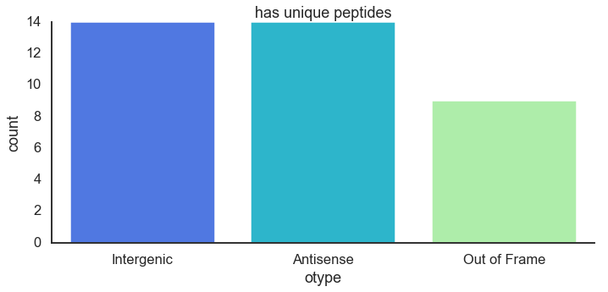
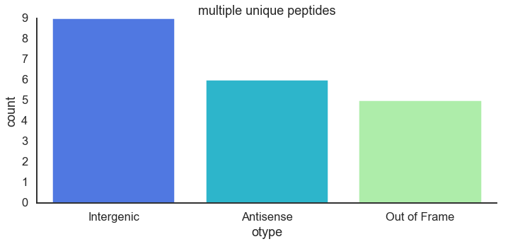
All ORFS in all lengths

Slide 3
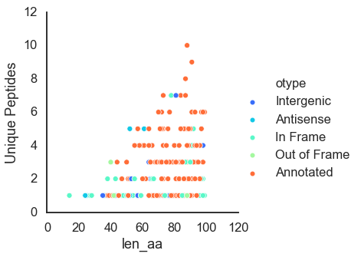
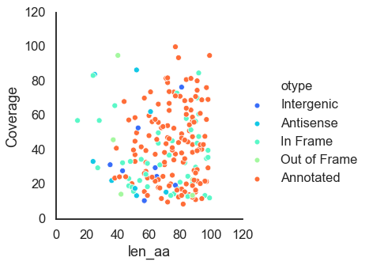
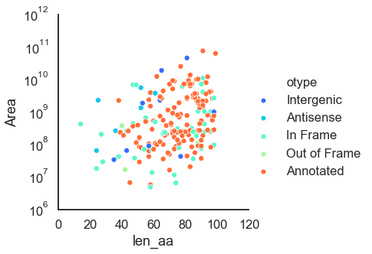
Number of unique peptides
coverage
area
Short proteins (upto 100 aa)

Slide 4
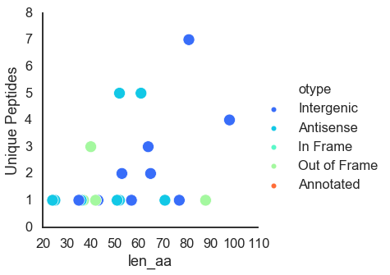
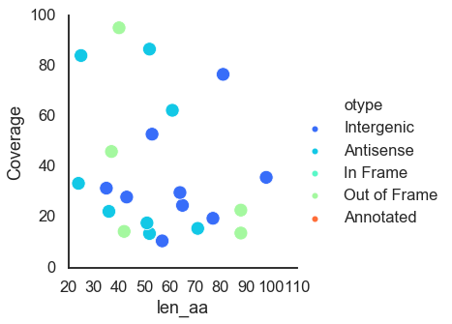
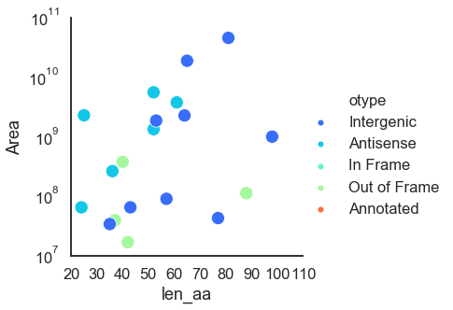
Number of unique peptides
coverage
area
Without annotated genes

Slide 5
Family | Count in original paper
CCRG-1 | 3
CCRG-2 | 12
ProcA | 29
procM | 1
In current annotation
family | product | Current ncbi | From paper
CCRG-1 | guanylate-binding protein | 1 | 1
CCRG-2 | CCRG-2 family RiPP | 12 | 3
 | CCRG-2 family protein | 3 | 3
ProcA | Nif11-like leader peptide family natural product precursor | 34 | 14
procM | lantipeptide-modifying enzyme LanM | 1 | 1

Slide 6
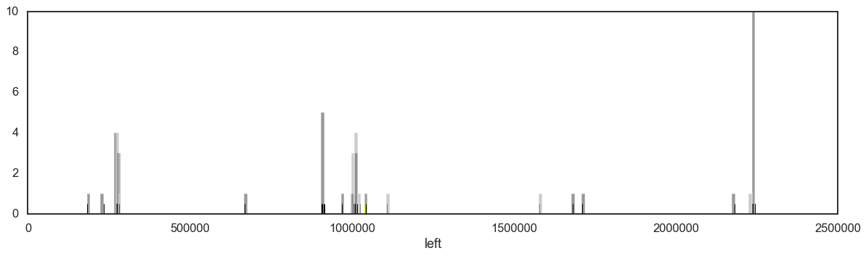
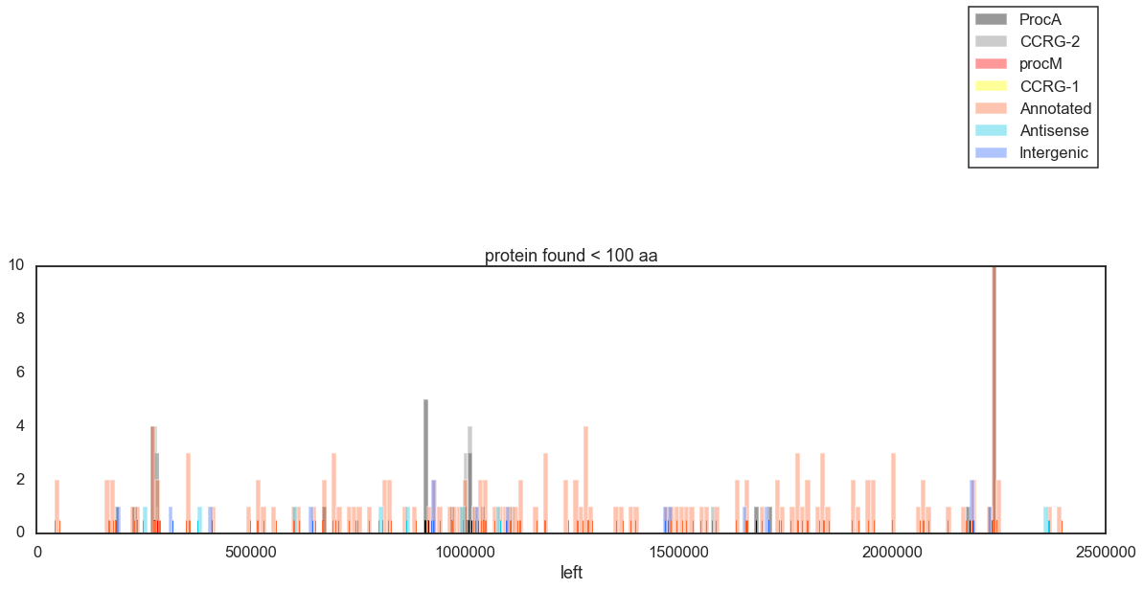

Slide 7
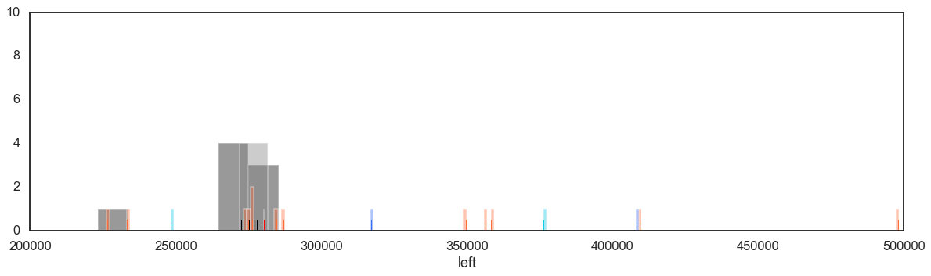
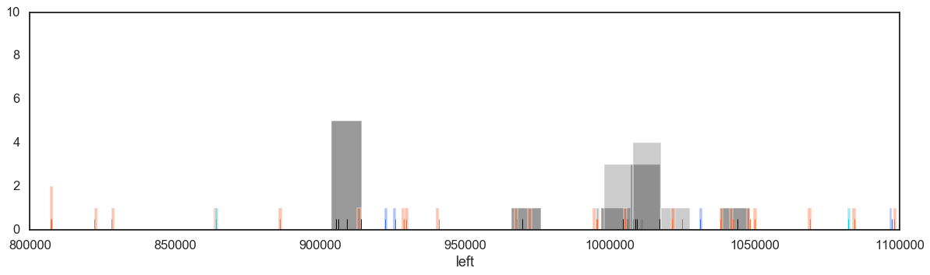
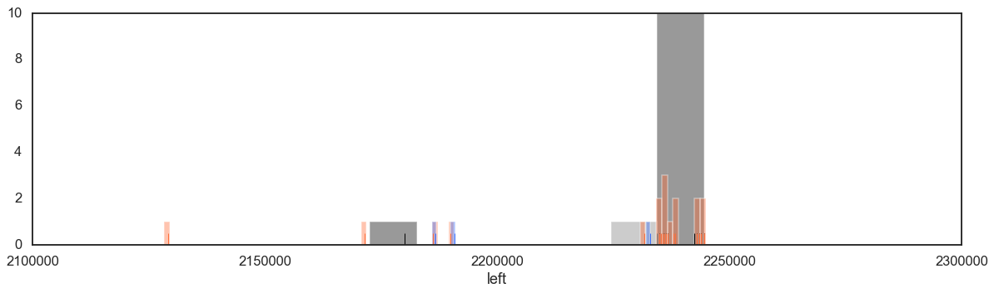
Zoom in

Slide 8
